Slide 1

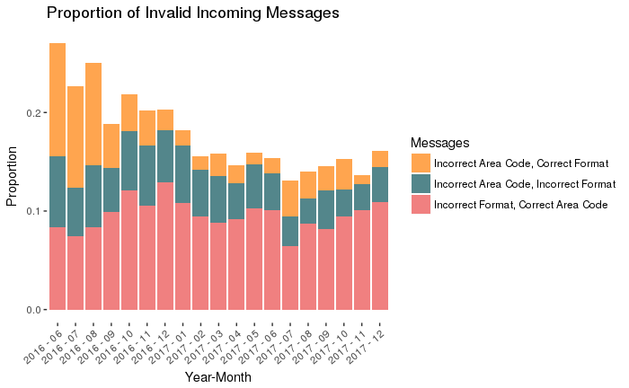
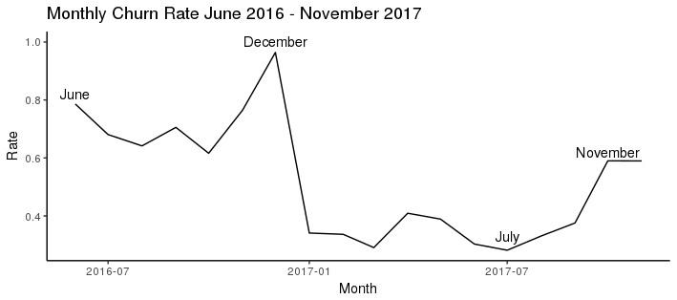
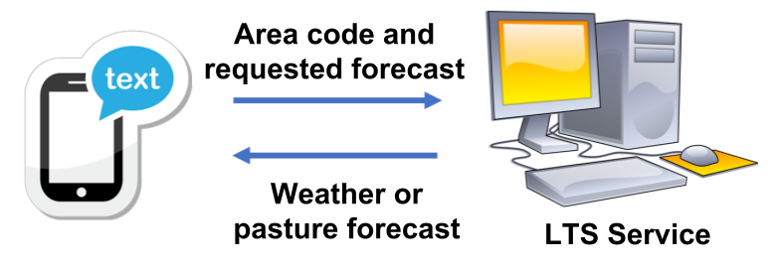
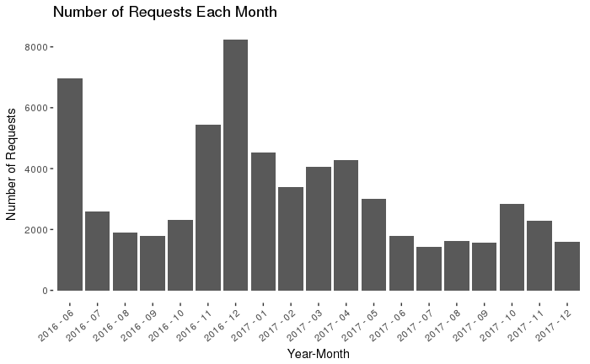
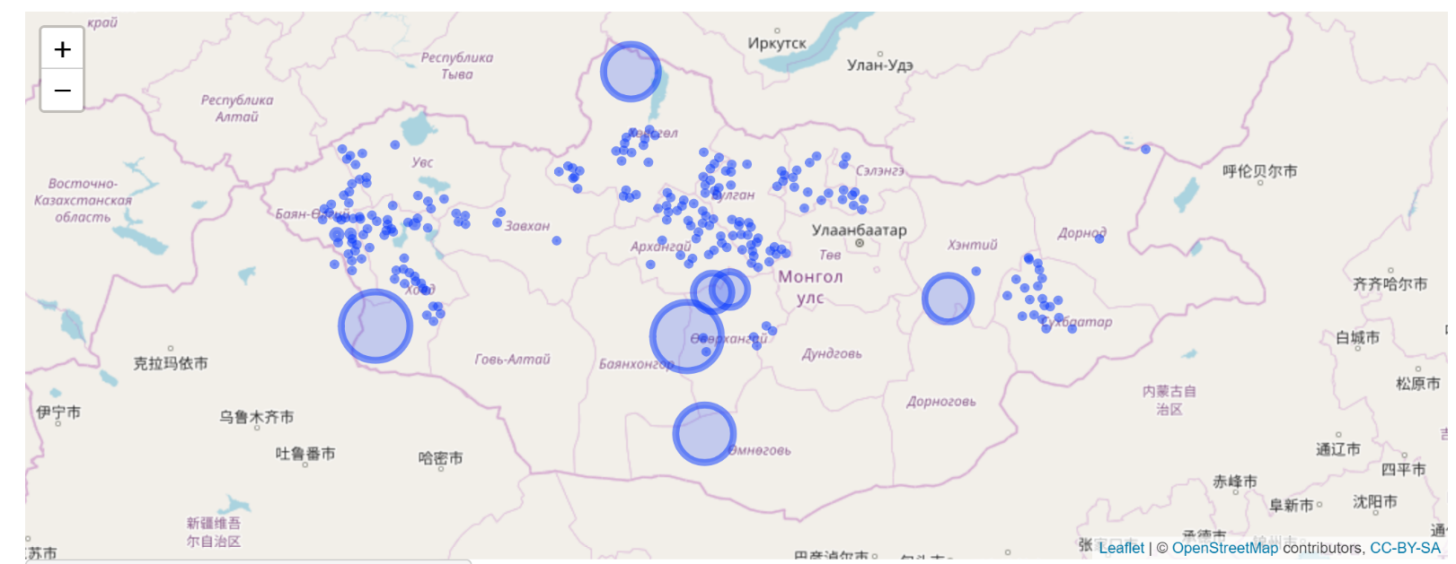
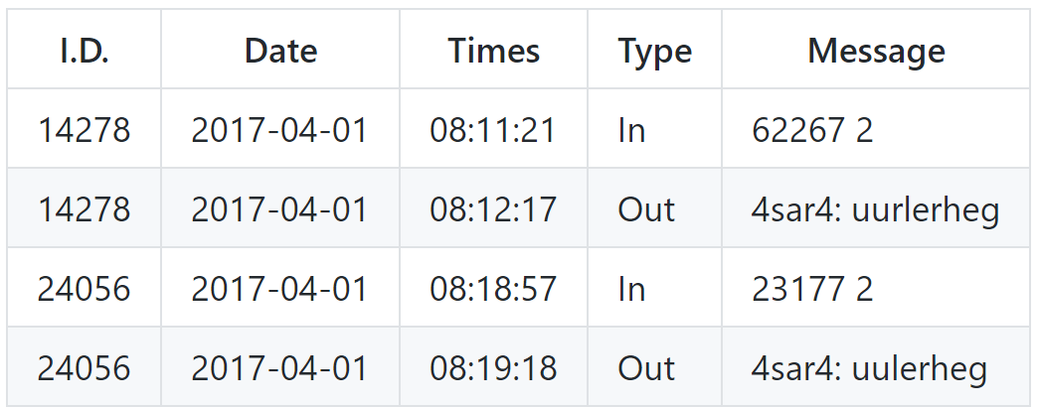
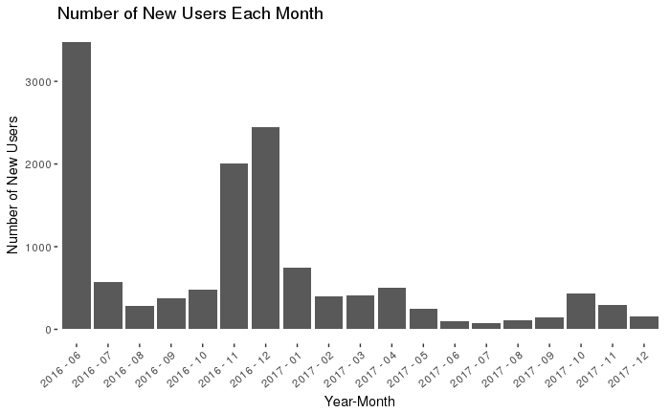
LTS-2 System: Exploratory Analysis of Service Usage Over Time and Space
Giovanni Corti, Wenxin Du, Ilana Heaton
Motivation and Research Questions
User Errors
Churn Rate
Approximately one third of Mongolians are pastoral herders. Extreme cold during winter presents a major risk livestock herds and thus poses a serious threat to the economic security of pastoral herders. In an attempt to create some sort of buffer, many herders obtain the largest number of animals possible. In some cases this leads to overgrazing which threatens the ecological sustainability of Mongolia’s extensive herding system. In an attempt to improve the survival rates of livestock, Mercycorp has developed a system to deliver weather forecasts and pasture information to herders. We analyze use of this system with a focus on spatial usage, temporal patterns and characterizing the average user.
Users commonly send in requests that are either incorrectly formatted or request information for area codes that do not exist. As Figure 2 shows, between 15%-25% of messages are invalid. Invalid messages receive no responses.
The LTS-2 system is not comprised of a constant user base. Instead new users are frequently joining and existing users are frequently exiting the system.
The flux of the user base can be quantified by calculating the churn rate. Churn rate is defined as the proportion of people who use the system for the last time in a given month. It should be noted that users are tracked by phone number so a user who changes phone numbers will appear as having dropped out of the system. This may help explain the extremely high churn rate in December of 2016.
The LTS-2 System
The LTS-2 system is an SMS information system designed to help Mongolian nomadic herders improve livestock outcomes. The system works by providing weather forecast and pasture information to herders through text message. One to three and four to six day weather forecasts are available in addition to pasture forage information from the Livestock Early Warning System (LEWS).
Figure 4. Churn rate of the system calculated on a monthly basis.
Figure 2. The proportion of invalid messages each moth along with the cause of the error.
Use over time
Spatial Analysis and Shiny App
The LTS-2 system exhibits a seasonal cycle although its overall usage seems to be decreasing. Use of the system spiked during November and December, however the magnitude of these spikes was much larger in 2016 as compared to 2017. The system saw a fairly consistent number of requests during the summers of 2016 and 2017.
We find that the vast majority of users are only interested in forecasts for one or two areas. We also construct a web based interactive map that allows users to visualize the spatial distribution of forecast requests. The app allows for the users to specify a time interval during which the requests occurred along with the type of forecast requested. The app can be found at shiny.reed.edu/s/users/giocorti/NHMap. A general examination of this map shows that requests are concentrated in the northern part of the country.
Figure 1. A schematic of the LTS-2 system
The Data
The data is comprised of incoming and outgoing messages and contains approximately 125,000 observations. Telephone numbers have been replaced with random unique identifiers in order to protect the privacy of individual users. Correctly formatted messages contain a valid five digit area code and an integer from 1-3 that specifies request type.
Figure 5. A screenshot of the interactive web map. The size of the circles corresponds to the number of requests from a particular area.
Table 1. A small subset of the raw data. Phone numbers have been changed to random unique identifiers.
Figure 3. The total number of requests received by the LTS-2 system
Conclusion
We examine user behavior and analyze the spatial and temporal usage of the LTS-2 system. We find:
A strong spike in usage during the winter of 2016 that is not repeated in winter 2017.
Many users have trouble sending correctly formatted messages and there is a very high churn rate among users
Most users are only interested in forecasts for one or two area codes
We suggest responding to incorrectly formatted requests with an error message that contains details on how to correctly format a request. Finally, A shiny app is accessible at shiny.reed.edu/s/users/giocorti/NHMap/ to allow for interactive visualization of the spatial distribution of requests.

